Slide 1




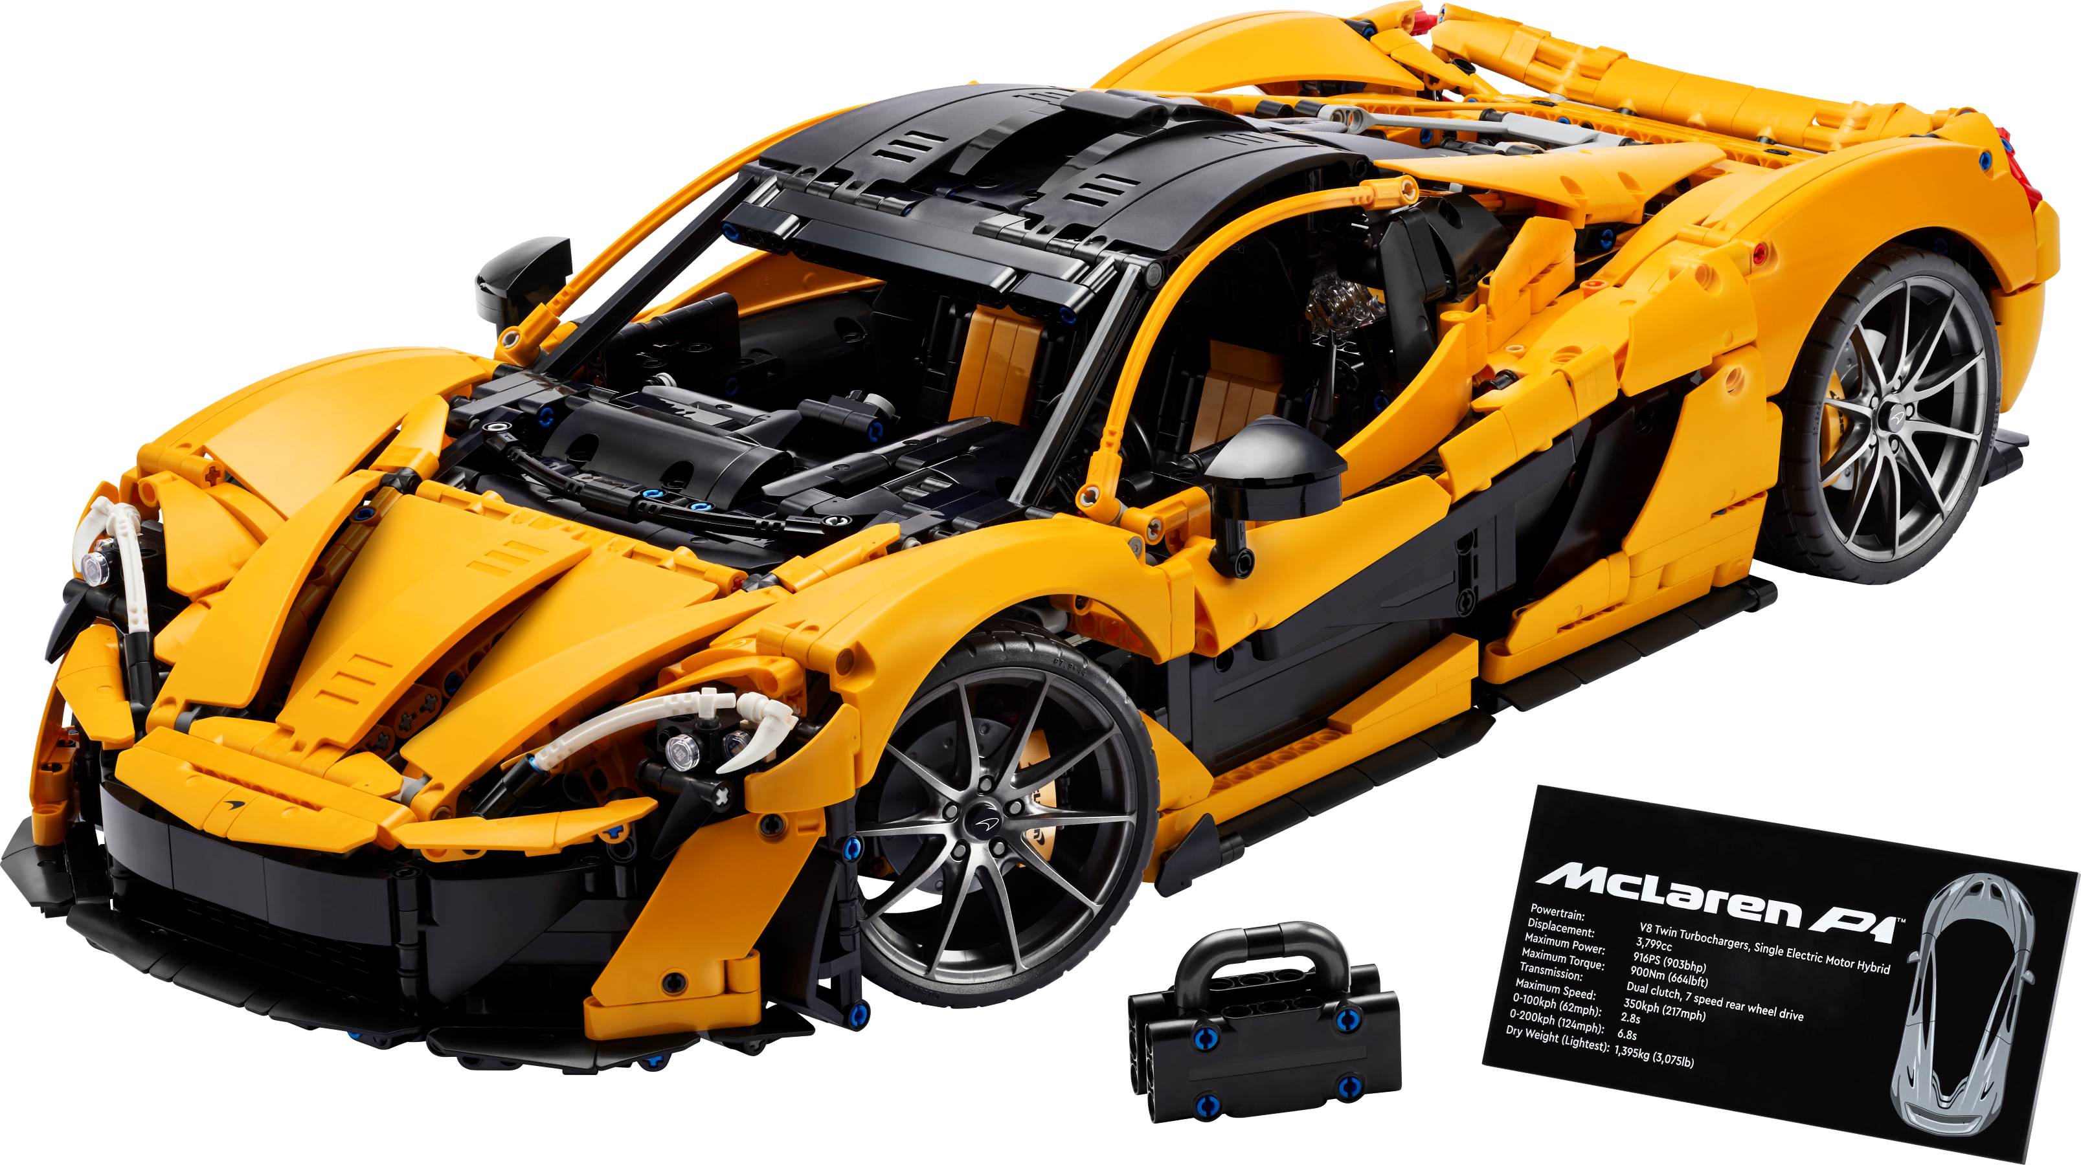
DOE Analysis: Lego Race Car
Team 201:
Satya Madhuri Varupula

Slide 2

Introduction and design ideas
DOE Approach:
A structured approach investigate how factors (e.g., Size of Wheels , Wheelbase Length, , Length of Car, Number of Wheels) affect a response variable (e.g., Distance Traveled).
Involves selecting factors, randomizing experiments, collecting data, and analyzing results to identify optimal settings.
DESIGN IDEAS:
Maximize the car’s travel distance.
Reduce the amount of material used.

Slide 3

MODEL SETUP
. Objective: Optimize the Lego car’s distance traveled by evaluating the effects of Wheel size, Wheelbase Length, Length of Car, and Number of Wheels.
Factors and Levels: Wheelbase Length , Number of Wheels, Length of Car, and Wheel Size, each with two levels (-1, +1), impact stability, aerodynamics, and rolling resistance.
3. Controls:
• Fixed ramp conditions (angle = 30°, height = 12 cm, slope = 24 cm).
• Smooth, consistent releases to reduce variability.
• Minimized environmental noise (e.g., wind, uneven surfaces).
4. Response Variable: Distance traveled by the car, serving as the measure of performance.
5. Design Considerations: Half factorial design analyzes effects, with randomized runs to prevent bias and uphold assumptions.
Data Collection: Distance traveled is measured for all 2³ combinations with randomized, consistent runs to ensure accuracy and reliability.

Slide 4




1.Wheel Size - Larger wheels may reduce rolling resistance and enhance the car’s ability to maintain speed, while smaller wheels can lower the center of gravity for better stability. The variety of wheel sizes in the kit provides an opportunity to experiment with configurations that maximize distance traveled.
2.Wheelbase Length - A well-calibrated wheelbase is critical for ensuring that the car maintains balance and minimizes energy loss due to tipping or misalignment during its descent on the ramp. It also affects how the car interacts with the ramp's surface, potentially enhancing straight-line motion.
3. Length of Car- A longer car improves stability by lowering the center of gravity and evenly distributing weight but may increase drag and rolling resistance; optimizing the length balances stability and aerodynamics to reduce energy loss.
4. Number of Wheels - More wheels improve load distribution and stability but may increase friction; optimizing the number minimizes drag while maintaining balance to maximize distance.

Slide 5

Model considerations and challenges
1. Assumptions:
- The ramp will remain constant at angle- 30º, Height- 12 cm, Slope- 24 cm.
- Consistent and Smooth release of the Lego Car.
- Negligible environment influences
2. Interactions Effects
3. Data Validity
4. Challenges:
- Construction Variability
- Uncontrolled noise factors.

Slide 6

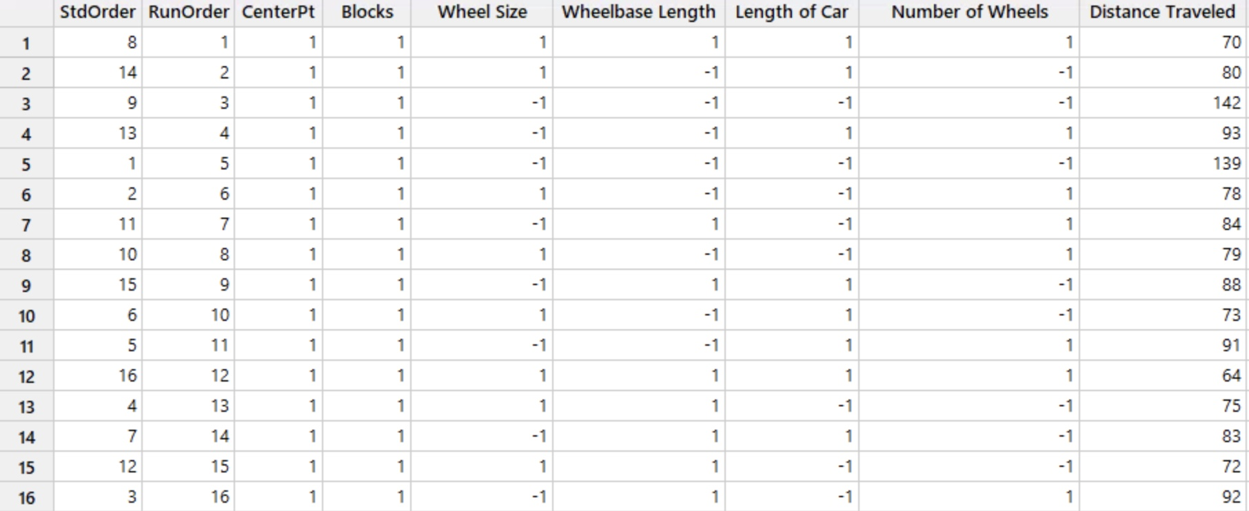
Factor table
Wheel Size (A) | (-1) large (1) Small
Wheelbase Length(B) | (-1) Small (1) Large
Length of Car | (-1) Small (1) Large
Number of Wheels | (-1) 4 wheels (1) 6 wheels

Slide 7
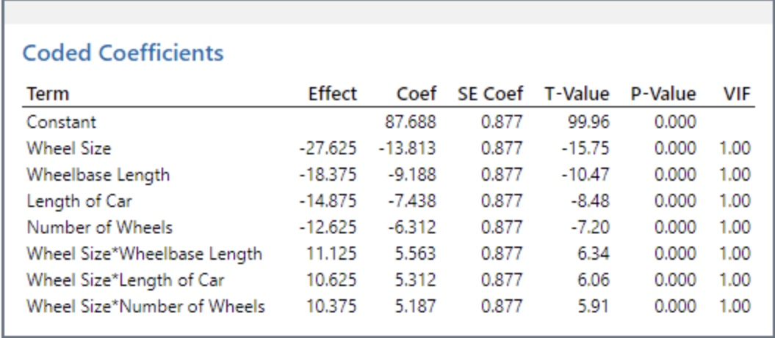

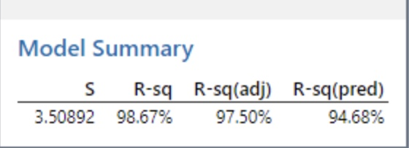
Effects and P values
1.Wheel Size (A):
• Significant negative effect on the response variable.
• Indicates that increasing wheel size reduces the performance metric.
Highly significant (p < 0.05), confirming its critical role in influencing the response variable.
2.Wheelbase Length (B):
• Significant negative effect; longer wheelbase likely increases drag and reduces energy efficiency.
• Highly significant, showing its considerable impact on performance.
3.Length of Car (C):
• Moderate negative effect; longer cars may add drag and reduce speed.
• Significant and contributes meaningfully to the response.
4. Number of Wheels (D):
• Smallest negative effect; more wheels increase friction, reducing performance.
• Less Significant, though its effect is weaker compared to other factors.

Slide 8

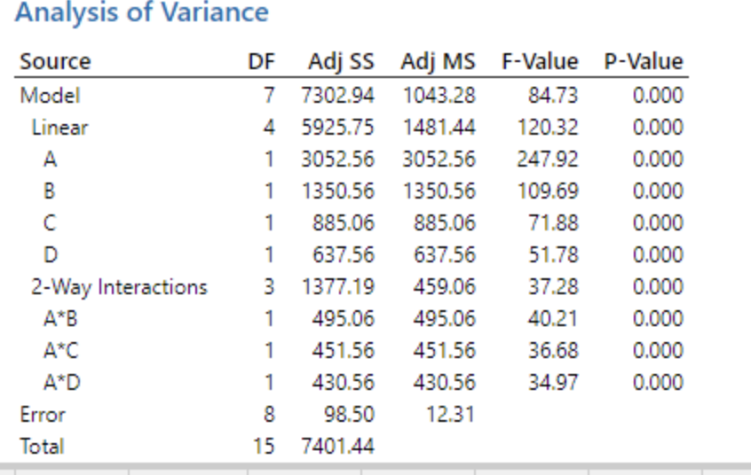
Anova table
Analysis of Variance (ANOVA)
Critical Factors:
* The largely significant main effects of Wheel size(A), Wheelbase length(B), and Car Length(C) indicate that these factors are important ones to be optimized for optimization of distance traveled.
• Significant Variables: All main effects (A, B, C, D) and their two-way interactions (A*B, A*C, A*D) have p-values < 0.05, confirming statistical significance.
• F-Values: The high F-values for factors A (247.92) and B (109.69) suggest they have the strongest effect on the response variable.
• Proportion of Variance Explained (Adj SS): Factor A explains the most variance (3052.56), followed by B (1350.56), indicating these are the most influential factors.
* Model is highly significant, p=0.000, with very low variability in error which suggests that the model fits the data very well.

Slide 9
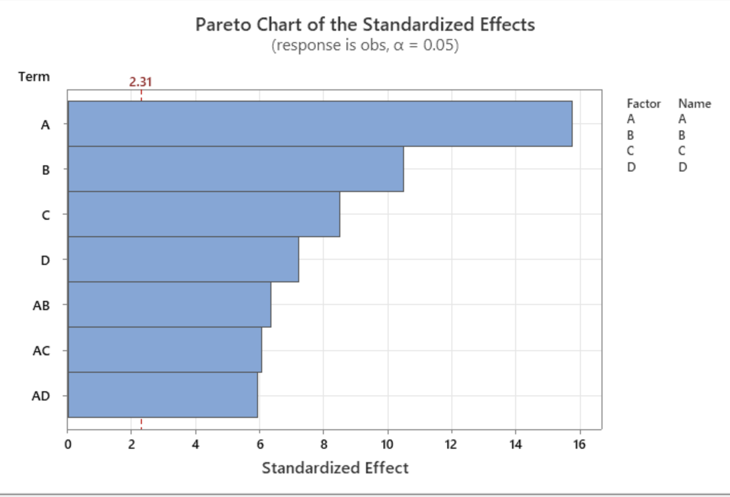
Pareto Chart
1. Most Significant Factor:
• A (Wheel Size): The longest bar in the chart represents the most significant positive impact on the response variable (distance traveled). Factor A has the highest standardized effect above the threshold (2.31), confirming its critical role in performance.
2. Other Significant Factors:
• B (Wheelbase Length): The second longest bar, indicating a strong influence but with a lesser effect than Wheel Size.
• C (Car length): The third most significant factor, still above the significance threshold, contributing meaningfully to performance.
3. Interaction Effects:
• AB, AC, AD: Interactions between Wheel Size and other factors (Axle Base, Wheelbase Length, etc.) have moderate effects but remain significant, contributing to overall performance optimization.

Slide 10
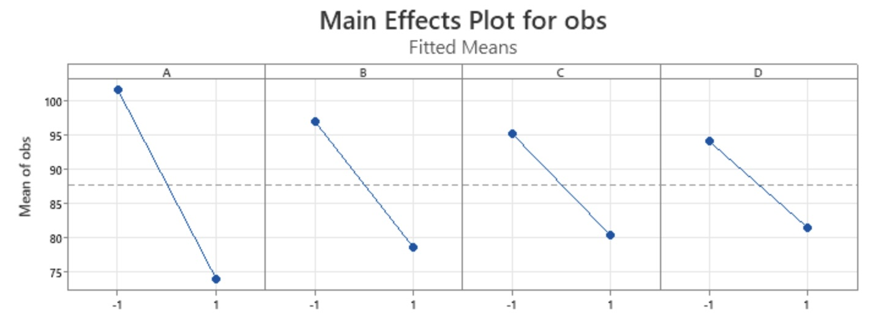
Main Effects Plot
1. Wheel Size (A):
• Shows the steepest negative slope, indicating the strongest impact on the response.
• Smaller Wheel Size (-1) significantly improves performance.
2. Wheelbase Length (B):
• A clear negative trend; performance decreases as Wheelbase Length increases.
• Shorter Wheelbase (-1) is more effective for optimization.
3. Length of Car (C):
• Moderate negative slope, indicating a decrease in performance with increased Car Length.
• Shorter Car Length (-1) contributes positively to the response.
4. Number of Wheels (D):
• Slight negative slope, showing the least impact among all factors.
• Fewer Wheels (-1) offer a slight improvement in performance.
Key Insights:
• Strongest Effect: Factor A (Wheel Size) has the most significant impact, followed by Factor B (Wheelbase Length).
• Optimization: Levels -1 for all factors yield optimal performance.
• Least Impactful: Factor D (Number of Wheels) has the weakest influence on performance.

Slide 11
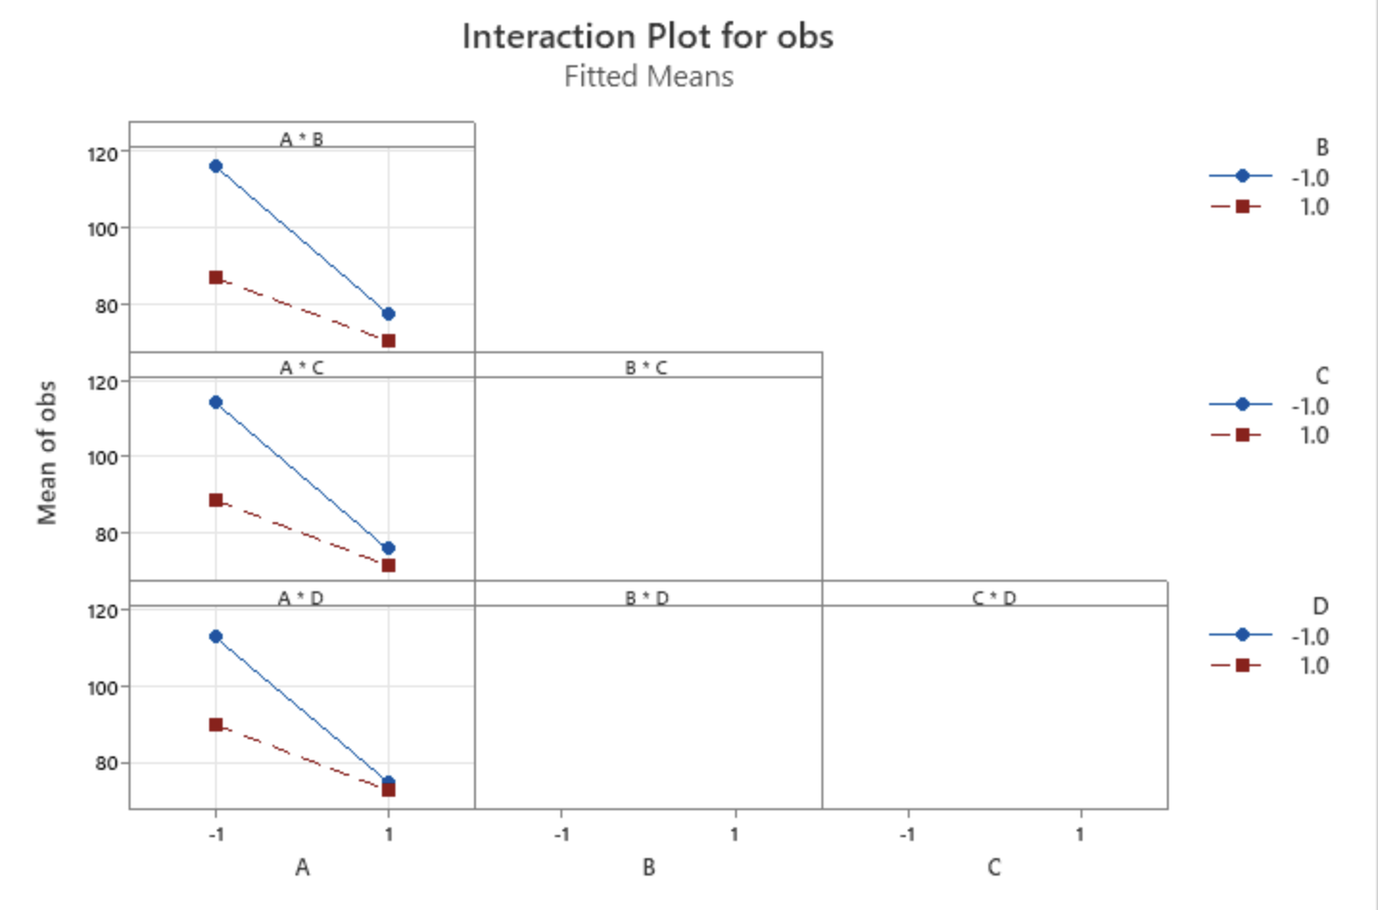
Interaction plot
Interaction Plot Analysis
1. A × B (Wheel Size × Wheelbase Length): Strong interaction; shorter Wheelbase (-1) enhances the impact of smaller Wheel Size (-1).
2. A × C (Wheel Size × Length of Car): Moderate interaction; shorter Car Length (-1) improves the effect of smaller Wheel Size (-1).
3. A × D (Wheel Size × Number of Wheels): Moderate interaction; fewer Wheels (-1) amplify the effect of smaller Wheel Size (-1).
4. Other Interactions (B × C, B × D, C × D): Minimal impact with parallel lines.
Key Insight: A × B is the most significant interaction, while A × C and A × D also moderately influence performance.

Slide 12
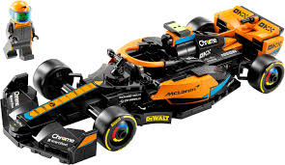
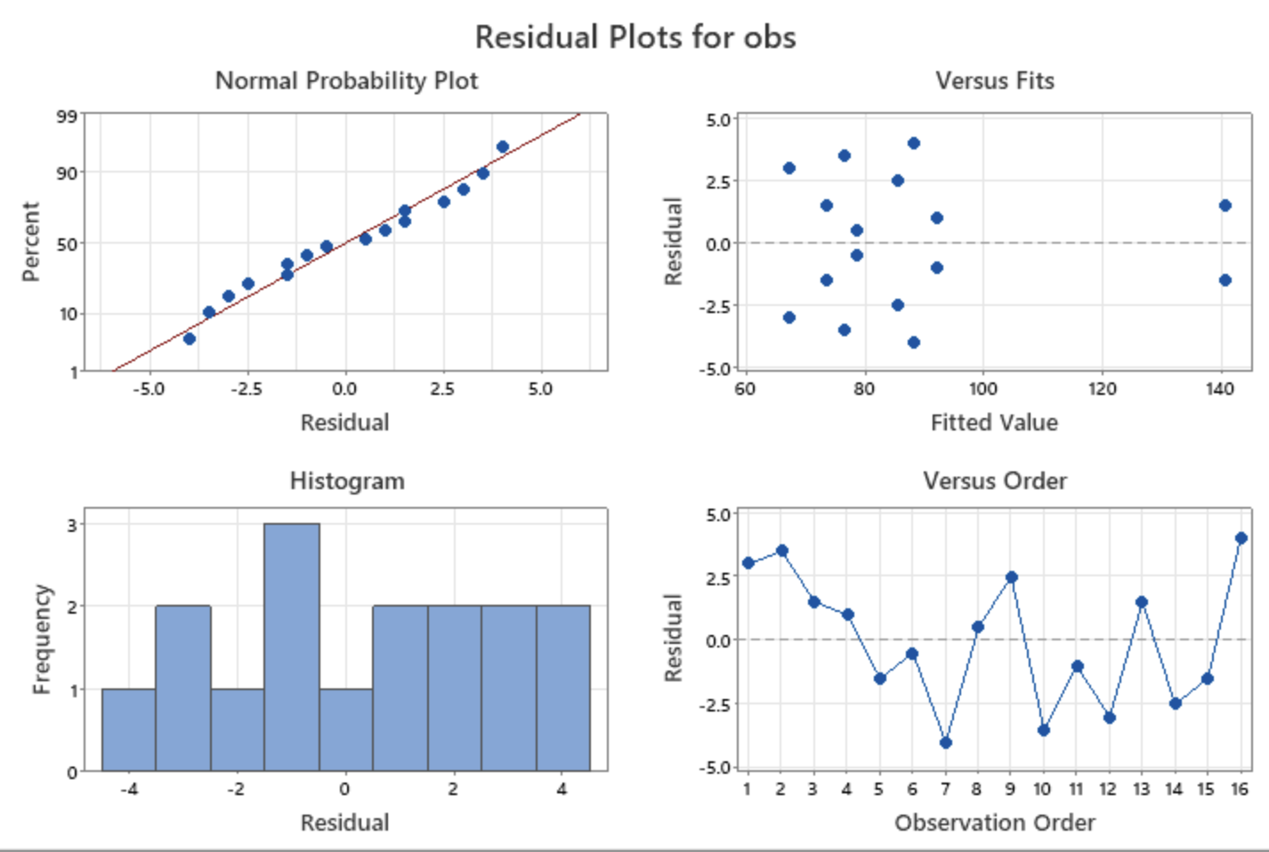
Residual plots
Residual Plot Analysis
1. Normal Probability Plot: Residuals closely follow a straight line, confirming normality.
2. Residuals vs. Fitted Values: Random scatter indicates constant variance (homoscedasticity).
3. Histogram: Symmetrical distribution supports normality.
4. Residuals vs. Order: No trends, confirming independence.
Key Insight: Residuals meet regression assumptions, validating the model’s appropriateness.

Slide 13
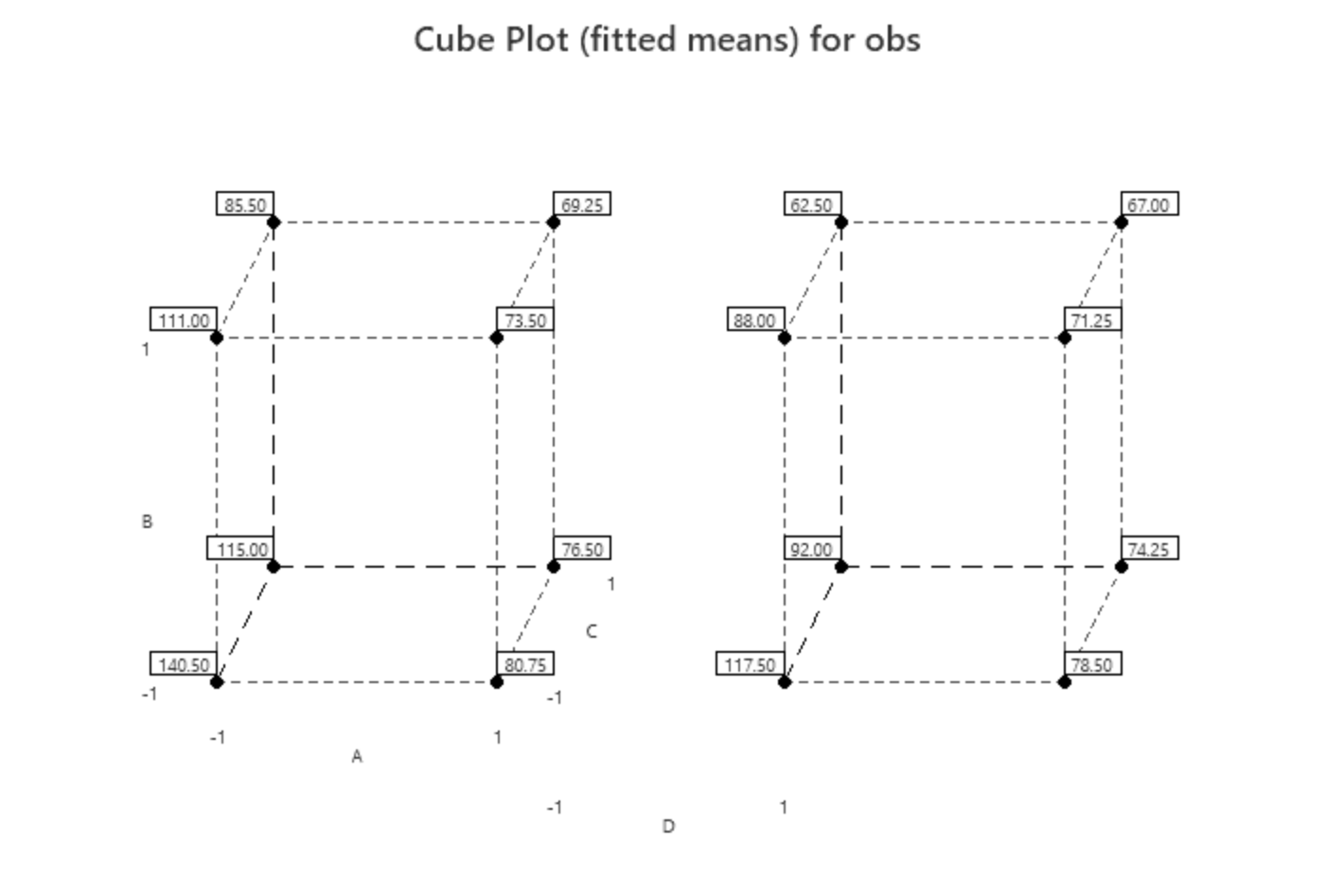
Cube plot
Cube Plot Analysis
• Best Performance (140.50): Achieved with A = -1, B = -1, C = -1, and D = -1 (Bigger Wheel Size, shorter Wheelbase, shorter Car Length, 4 Wheels).
• Lowest Performance (62.50): Observed with all factors at level 1, showing larger values reduce performance.
• Factor Impact:
• Wheel Size (A): Bigger size (-1) improves performance significantly.
• Wheelbase Length (B): Shorter length (-1) boosts performance.
• Car Length (C): Shorter length (-1) positively influences results.
• Number of Wheels (D): 4 wheels (-1) slightly enhance performance.
• Key Insight: Lower levels (-1) for all factors maximize performance, with strong interactions between A and B.

Slide 14

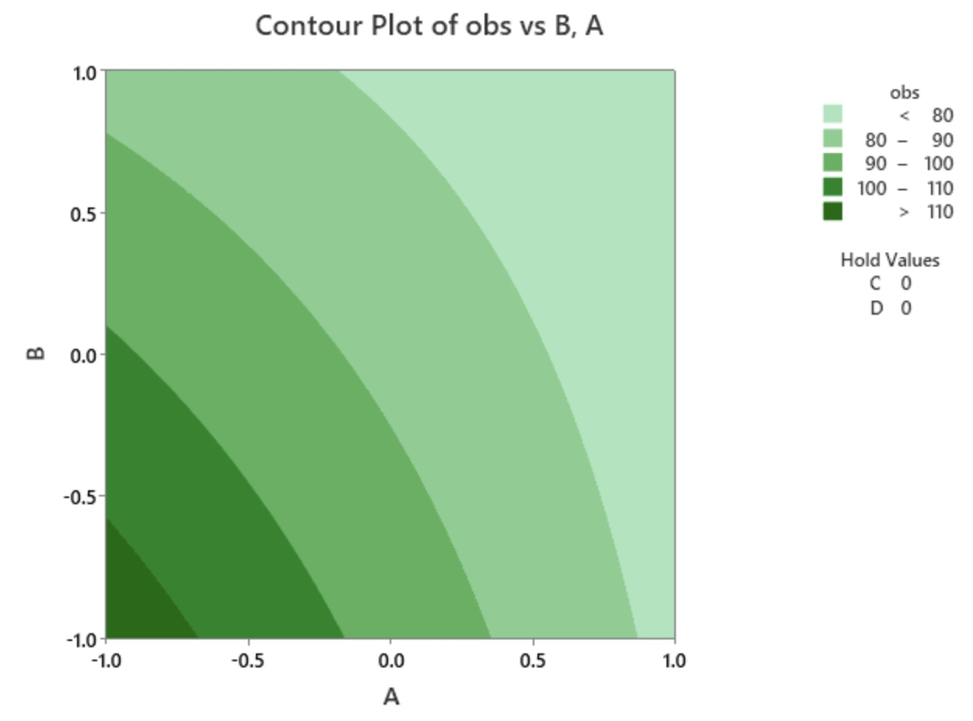
contour plot
Contour Plot Analysis
• High Response (Dark Green): The highest performance (distance traveled > 110) is achieved when Wheel Size (A) and Wheelbase Length (B) are both at lower levels (-1). This combination optimizes the response variable.
• Low Response (Light Green): Poor performance (distance traveled < 80) occurs when both A and B are at higher levels (1), showing their negative impact.
• Interaction: The gradient pattern highlights a strong interaction between A and B, with smaller values for both factors significantly improving the response.
Key Insight: Reducing both Wheel Size and Wheelbase Length to their lower levels (-1) yields optimal performance.

Slide 15

Conclusion
Best Model:
The main effects of Wheel size(A) and Wheelbase length(B) are highly significant.
The interaction plot Wheel size * Wheelbase length has a strong influence on the response.
Best Combination for Longest Tool Life:
Wheel size (A) = -1
Wheelbase length (B) = -1
Length of Car (C) = -1
Number of Wheels (D) = -1
Cost of the Car- $15,800
These are the variables that we have considered for designing our car model.

Slide 16
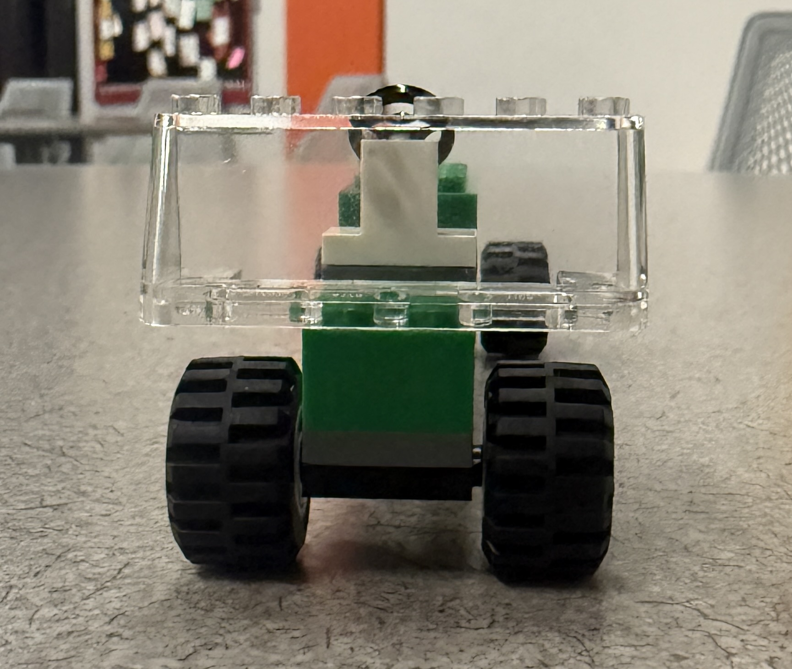
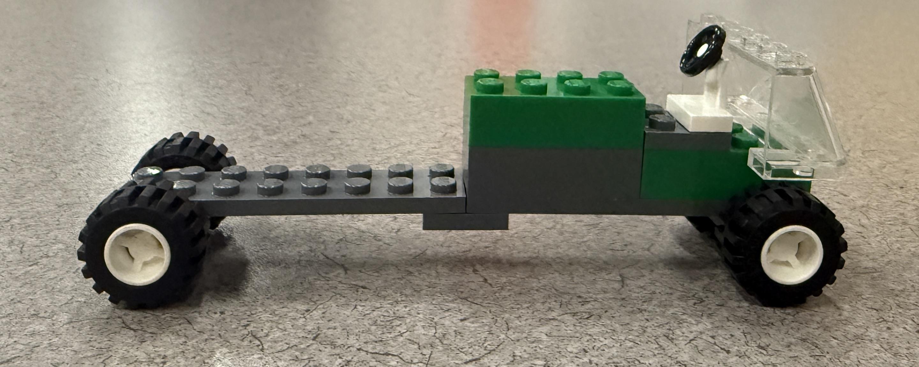
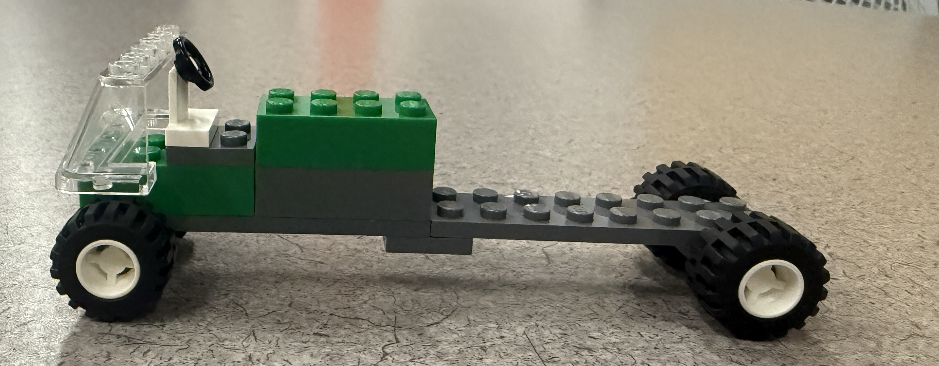
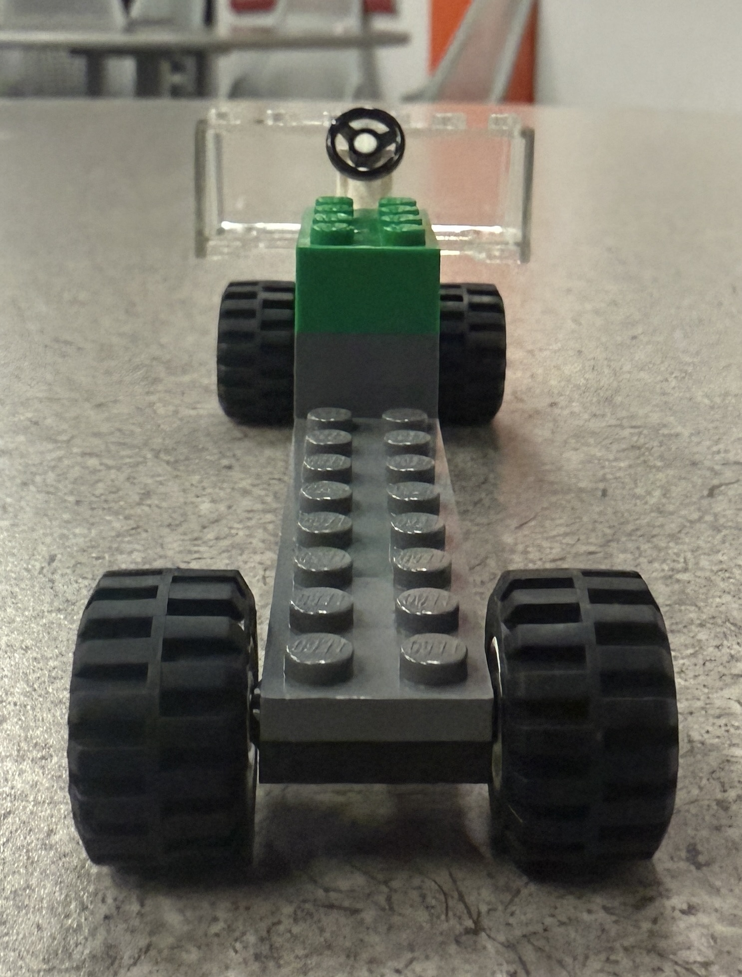
Thank you

